Slide 1

INST414-0101
Data Science Project
By: Brandon Leer

Slide 2
Description: Layoffs Analysis
For many seniors in college and recent new graduates finding a job with little to no experience on your resume, can be a difficult task.
In addition, many companies have announced significant layoffs such as Google, Amazon, Meta, Snap, Gopuff, Wells Fargo, and Credit Suisse according to investopedia
Question: Is there a trend in companies across the United States in 2022, where certain industries, stages of funding, and regions see less layoffs than others? By knowing how well these factors influence a companies layoff percentages new graduates can tailor their job search to find the most opportunity?

Slide 3
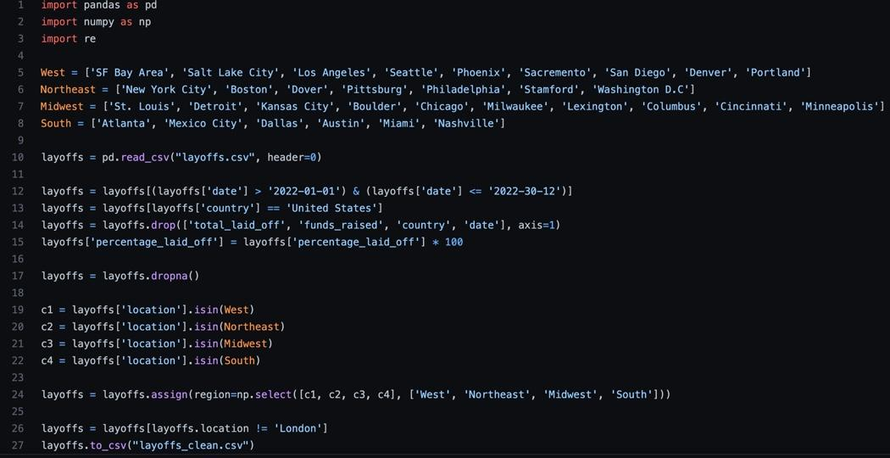
Method
Data downloaded as a csv file from Kaggles database.
Total of 1801 rows (companies) and 9 columns (company, location, industry, total laid off, percentage laid off, date, stage, country, funds raised.
Cleaning Steps
Adjusting the dates to only layoffs during 2022
Country column adjusted to layoffs in the United States
Dropped the total laid off, funds raised, country, and date columns
Multiplied percentage laid off column by 100
All na values were dropped
Region column separated the U.S cities into the Northeast, West, South, and Midwest
Resulting data frame was 482 rows and 5 columns representing individual companies.

Slide 4
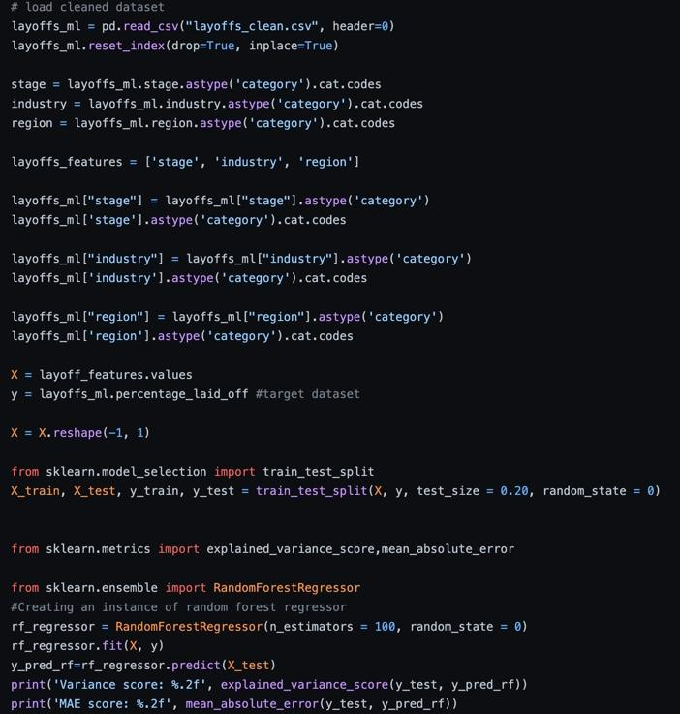
Machine Learning
The industries, stage of funding, and region variables had to be numerically encoded using cat codes first
The cleaned dataset was then split into a training set and a test set
20% of the data would be for testing and 80% would be for training
The Random Forest Regression algorithm was then used on the dataset to produce a model that would predict a company's percentage of layoffs.

Slide 5
Analysis
Results
Model had a variance score of about 27%, which means that the predictor variables can explain 27% of the change that is happening with the company layoff percentages.
Region, stage of funding, and industry will not be able to likely predict how many people a company lays off
Model also had a mean absolute error of about 14.57%, which is acceptable
Conclusion
From the analysis, it was found that there is not trend, as the model was not able to explain a high percentage of the change in layoffs.
Therefore, for example it cannot predict how many layoffs a company would have if it were for example a companies located in the northeast region, ipo stage of funding, and in the finance industry.
In order for more robust model, it is recommended that a dataset with more records and factors such as company age and number of employees

